Slide 1
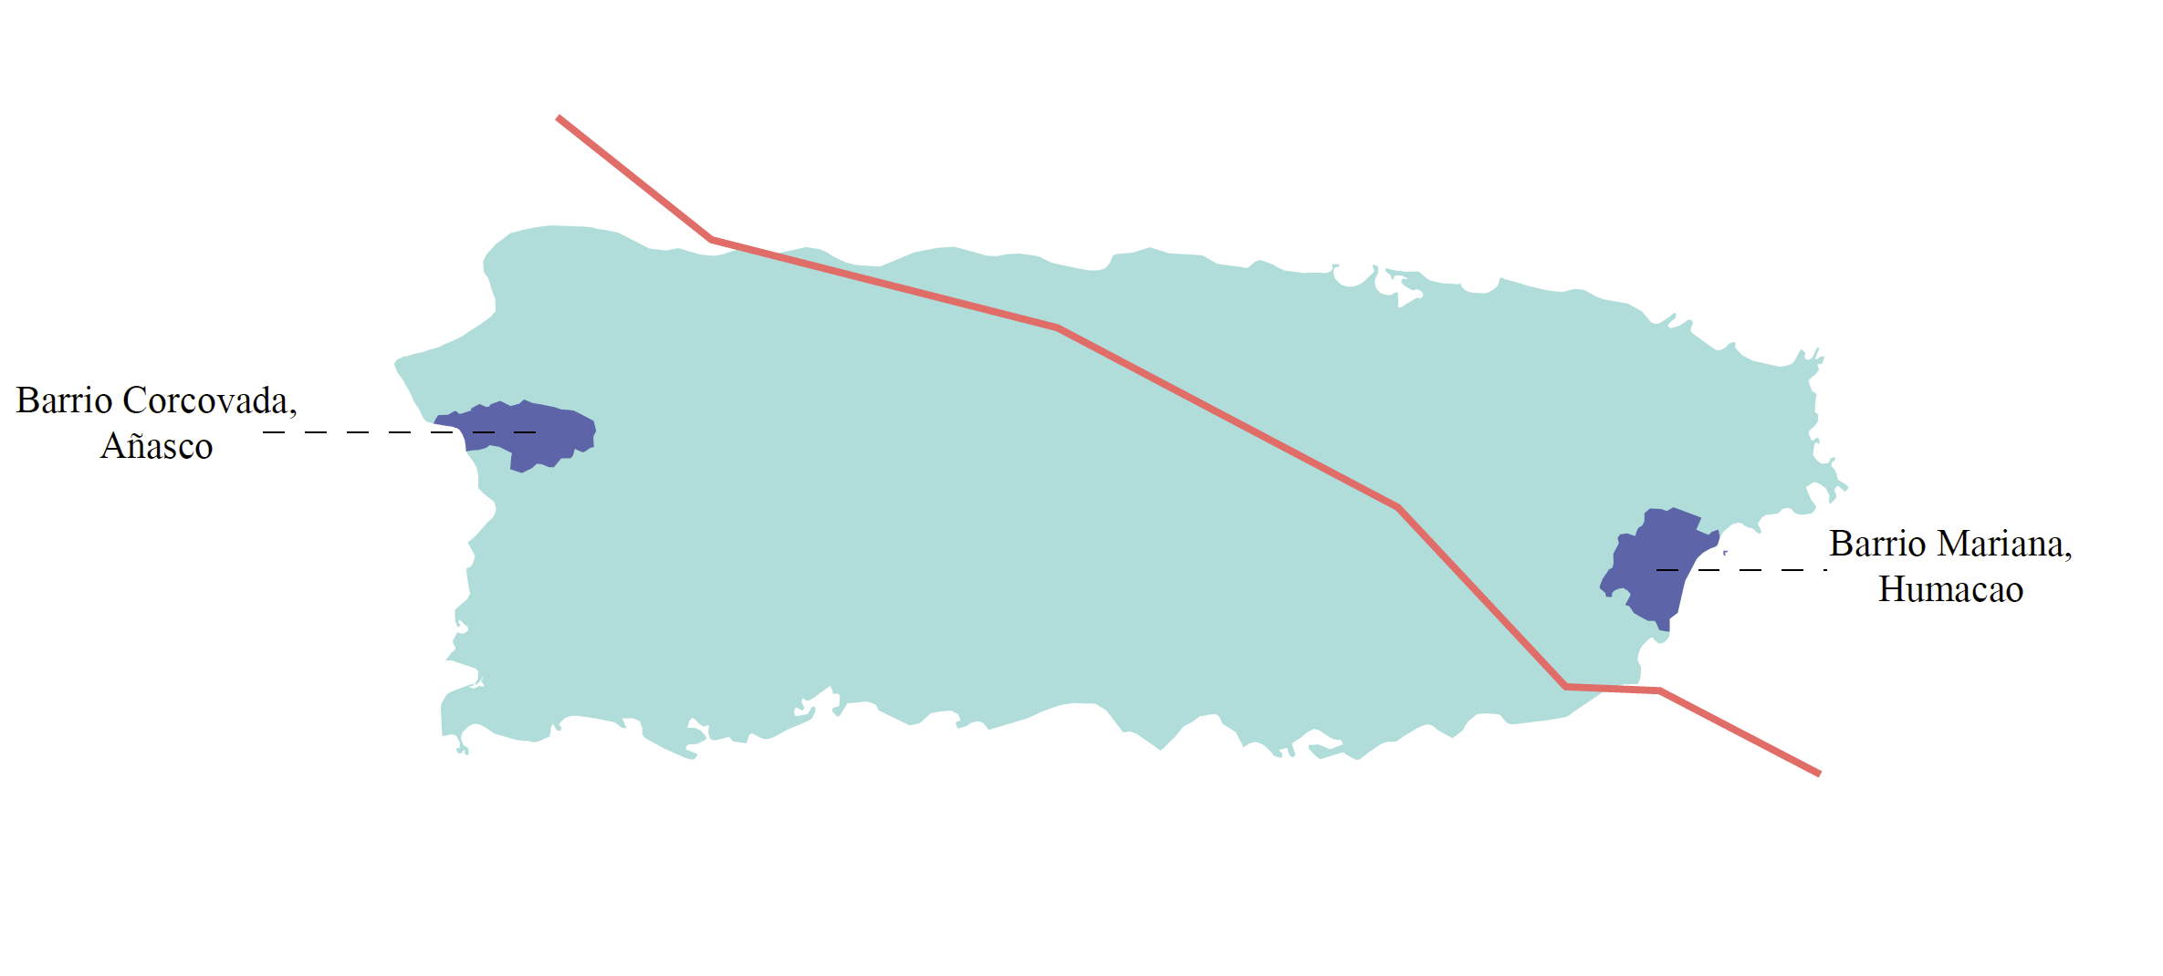
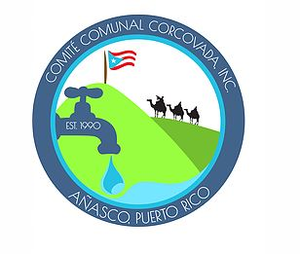
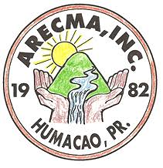
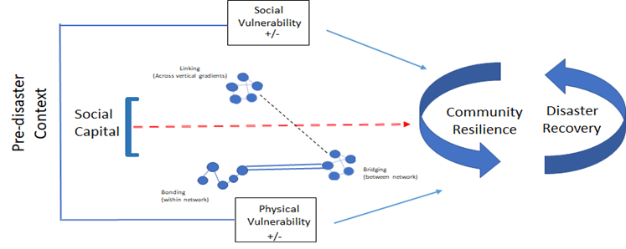
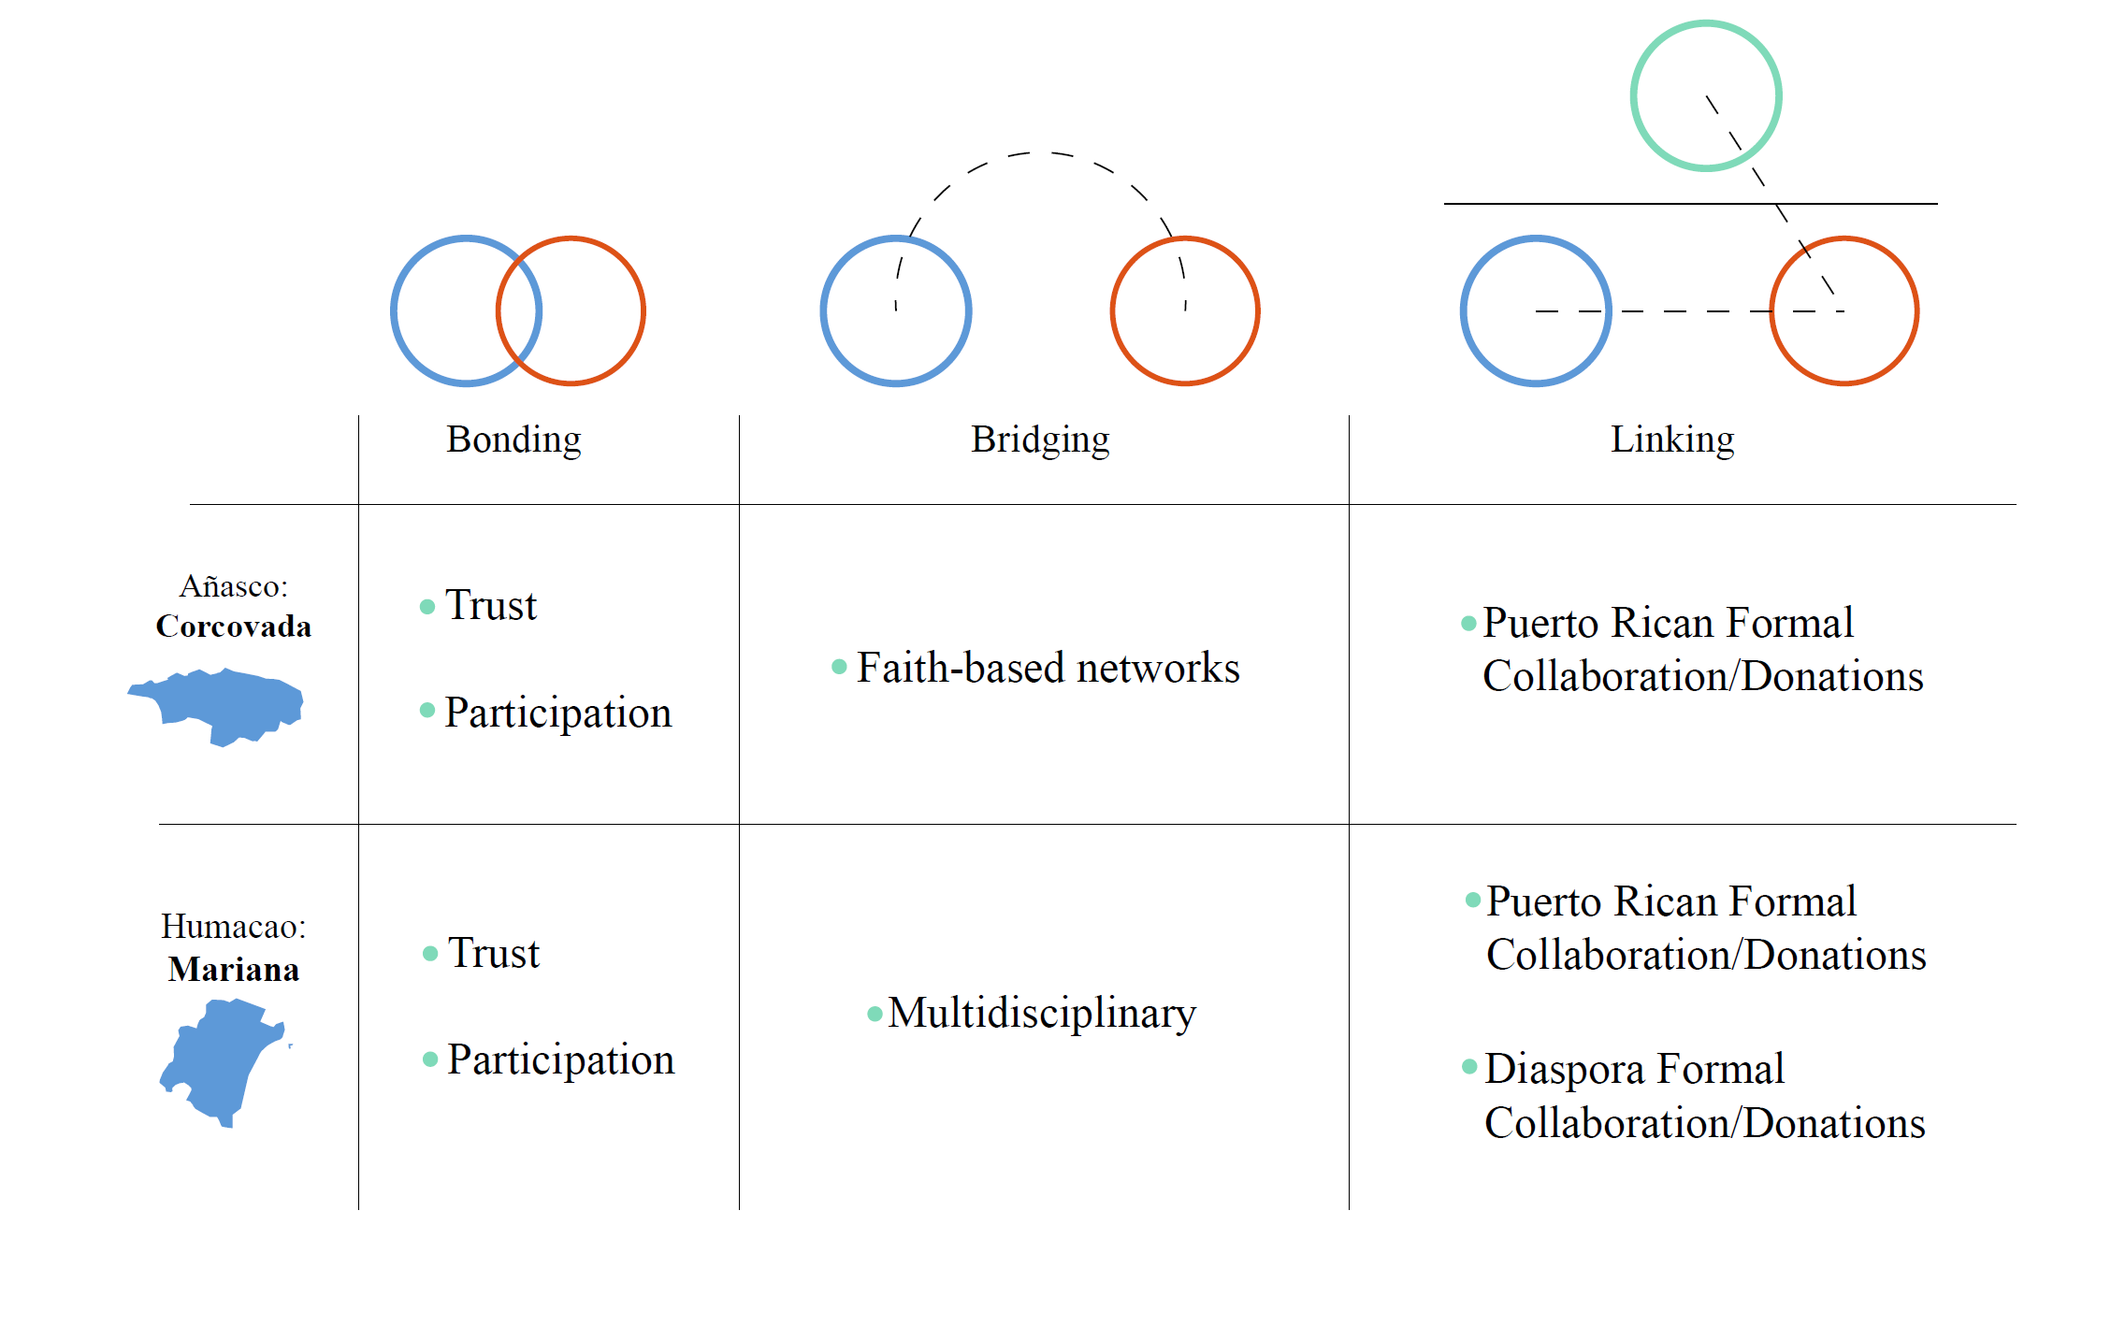
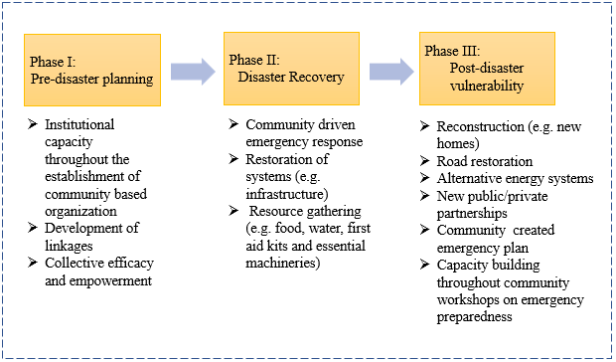
The Role of Social Capital in Resiliency: Disaster Recovery in Puerto Rico
Anais Delilah Roque
First year PhD Student – Environmental Social Science, ASU
How did the two barrios used social capital to reduce vulnerability in the recovery process of Hurricane María?
Background
The commonwealth of Puerto Rico is an unincorporated territory of the United States since 1898 located in the northeast Caribbean Sea between the Dominican Republic and the British Virgin Islands.
Within the socio-economic context, the island has confronted an economic and fiscal crisis which has resulted in 45% of the population living below poverty levels, high levels of welfare dependency and a population decrease of 500,000 over the past 10 years primarily due to limited employment opportunities.
Theoretical contribution
Community based organizations can serve as the institutions where social capital is fostered and strengthen in times of stress.
These case studies in two rural barrios of Puerto Rico highlighted that fostering social capital during “normal times” through a set of values, networks and reflections on a desirable future state can provide the ability to extend social networks and create coping mechanisms.
For communities with economic limitations, social capital can become a principal approach to reduce vulnerability, risks to disaster and as a means to recovery.
Since these two barrios prior hurricane Maria were already discussing issues associated to resiliency, social capital here was used purposefully to extend their networks in a way that would advance their resilience orientated projects.
Map of Puerto Rico with Hurricane María Trajectory and
Logos of Corcovada and Mariana Community based organization
Hurricane María and Social capital in disaster recovery
In Puerto Rico, Hurricane María is considered the strongest disaster to hit the island since Hurricane San Felipe II in 1928, with sustained winds of 155 miles per hour.
Lack of state government resources, laws such as the Jones Act (1917), the lack of congressional representation, geographical separation of more than 1,000 miles from the U.S. mainland served to diminish preparedness efforts and increased the level and extent of vulnerability.
Within such a scenario, this research looks at smaller legal division within municipality boundaries called barrios that have been organized before the hurricane and how social capital—in terms of the shared values, collaboration capacity and community organization—facilitated resource gathering to create a buffer and reduce vulnerability in the aftermath of Hurricane María.
Practical implications
To foster social capital, there is a need to prepare communities with participatory processes and activities such as a community visioning exercise.
Having a community organization with a unified vision and mission allows other types of capacity building events to advance their objectives.
An example of this are workshops that address writing proposals because this can show that the community has the capability to articulate their desires as well as how they will be managing community development projects.
The community needs to nurture ties and personal relations with external networks to build partnerships across scales (local, national and international). This is important because it will also attract financial aid and educational resources for community knowledge and development.
Social capital in community resilience and disaster recovery
(with Aldrich, 2012 framework)
Social capital levels and the emergent subthemes across the two barrios
Barrio resiliency development in the three disaster phases
Case Studies:
Barrio Corcovada and Barrio Mariana
This study utilized a qualitative research design specifically, focused on two case studies. These two barrios have had community-based organizations for more than thirty years, and they bring a unique perspective that other communities (in urban and rural setting) can learn from in their ongoing efforts for hurricane recovery and disaster resilience. A total of 13 community leaders where interviewed for this project.
Bonding Social Capital example
Bridging Social Capital example
Acknowledgement and References:
This poster wouldn’t be possible without the community leaders from Mariana and Corcovada taking from their time to sit down with me and share their experiences. They are doing amazing work in their respective communities. Likewise, Dr. Amber Wutich and Dr. David Pijawka for their comments and contributions as my co-chairs of my masters research project.
Aldrich, D. P. (2012). Building Resilience: Social Capital in Post-Disaster Recovery, Chicago
Press. doi: 10 . 1017 /S 146810991300039 X
“….30 people came to ARECMA cooking facility saying, “I am willing to cook”…They were the ones who did everything. They were the ones who roamed around the space recovering people from the psychological, mental, physical scourge that had happened here, because really, the devastation here was very big.” PM4
“The challenges were big, but the community took the street, cleared the roads cut trees and they were working constantly in the community aqueduct. The church helped us a lot in this process. The Presbyterian church, the Catholic and other churches nearby brought food, water, and other provisions. The Presbyterian church at one point became a center for food and aid distribution.” PC4

